Slide 1
Big Mountain Ski Resort
Data analysis
and
Recommendations

Slide 2
Problem Statement:
Big Mountain plans on increasing operational costs by $1,500,000 this season and needs to offset this by increased revenues
The ski resort market is competitive and therefore ticket price changes are delicate and need to be fine-tuned
Big Mountain needs to determine how and to what extent different facilities affect supportable ticket prices using a data driven approach
A predictive analysis need to be made on rich ski-resort dataset of different competitors

Slide 3
History
Big Mountain Resort offers spectacular views of Glacier National Park and Flathead National Forest, with access to 105 trails. Every year about 350,000 people ski or snowboard at Big Mountain. The business expressed a desire for some guidance on how to select a better value for their ticket price. by considering number of changes hoping to reduce cost without reducing ticket price or increasing ticket price.

Slide 4
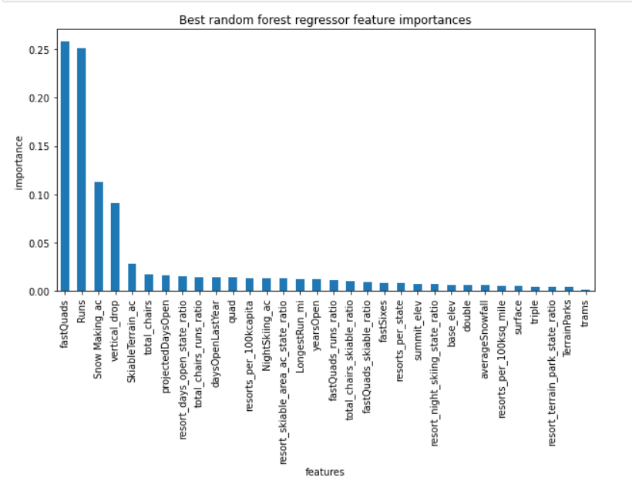
Key Findings:
The most important features are :
Total Chairs
Fast Quads
Runs
Longest Run
Trams
Skiable Terrain Area
Vertical Drop
Snow Making Equipment
Big Mountain is on the upper end for most facilities compared to competitors in the market
Big Mountain is underpricing their tickets by around $10
Increasing the length of the longest run or increasing snow coverage area has minimal impact on revenue

Slide 5
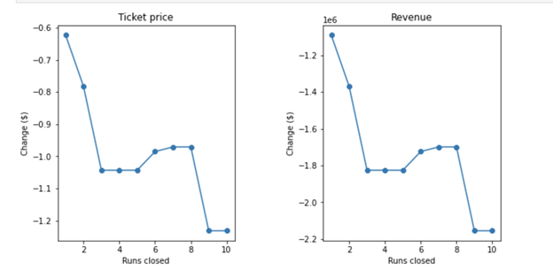
Closing up to 10 Runs vs (Ticket price & Revenue)
Big Mountain Resort has been reviewing a potential scenario for cutting costs by Permanently closing down up to 10 of the least used runs.
Our Model predicted the following when it comes to closing up to 10 used Runs:
Closing one run will have no impact on Ticket price or revenue.
Closing down 3 runs, it seems they may as well close down 4 or 5 as there’s same loss in ticket price and revenue by $0.67 and $1.250M respectively.
Closing 10 runs reduce support for ticket price and so revenue by $1.71 and $3M respectively.
Because we don’t know the operating cost per used run, we can’t determine how much cost saving will be offset the loss in revenue after closing more than one run

Slide 6
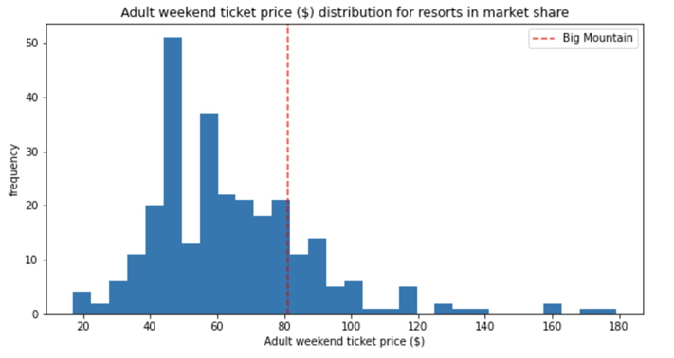
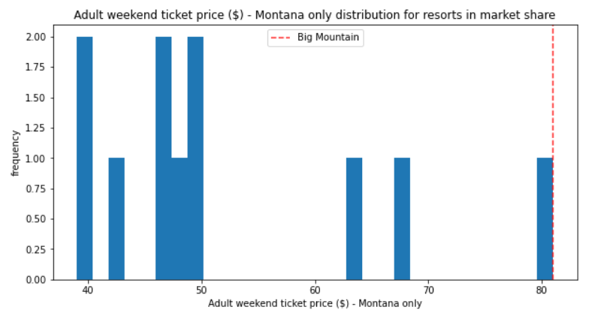
Big Mountain Ticket Price comparison in market
Big Mountain’s Ticket Price compared to other Resorts Ticket Price.

Slide 7
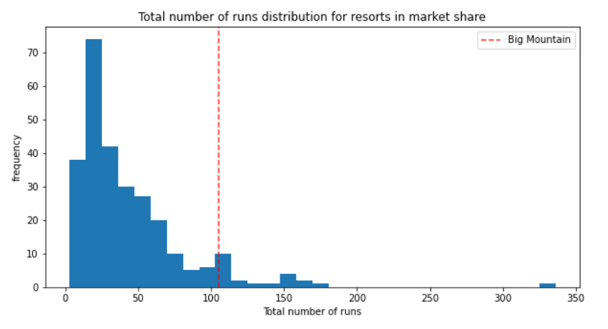
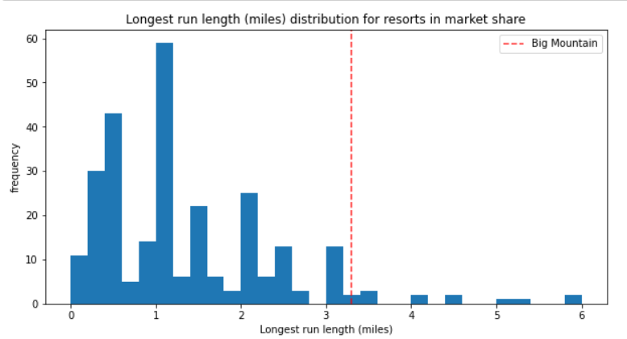
Big Mountain Ticket Price comparison in market
Big Mountain has one of the longest runs. Although it is just over half the length of the longest, the longer ones are rare.
Big Mountain compares well for the number of runs.

Slide 8
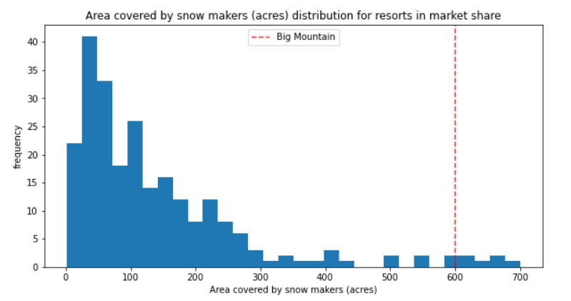
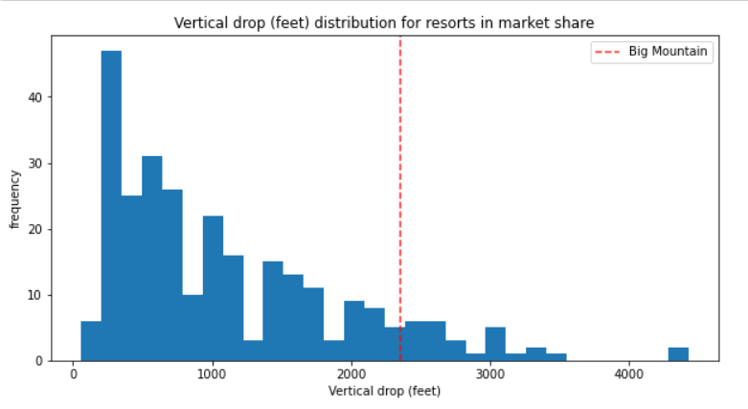
Big Mountain Ticket Price comparison in market
Big Mountain is very high up the league table of snow making area.
Big Mountain is doing well for vertical drop but there are still quite a few resorts with a greater drops.

Slide 9
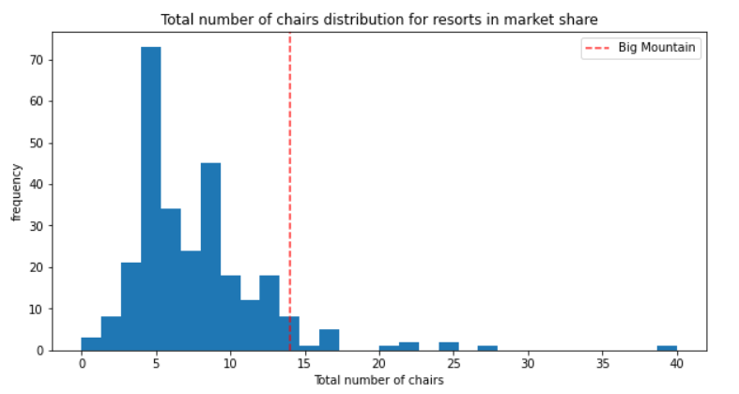
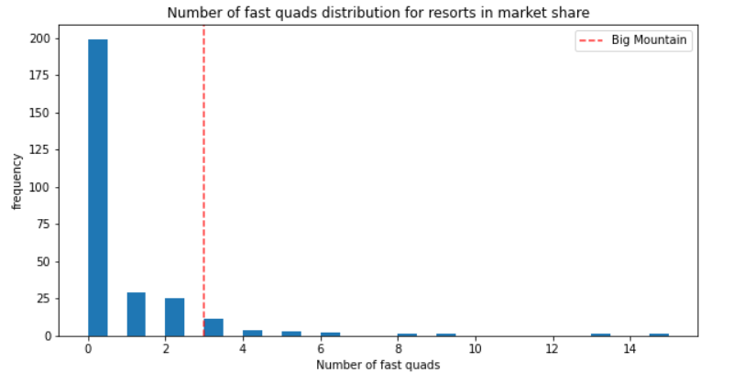
Big Mountain Ticket Price comparison in market
Big Mountain has amongst the highest number of total chairs, resorts with more appear to be outliers.
Big Mountain has 3 quads, which puts it high up that league table.

Slide 10
Conclusion
The model suggests that Big Mountain is underpricing their tickets so the company can probably increase prices marginally ,on increasing the price of their adult weekend tickets by $10 to $15.
Increase the vertical drop by adding a run to a point 150 feet lower down but requiring the installation of an additional chair lift to bring skiers back up, without additional snow making coverage
Big Mountain keeps the old price for weekdays, and adopts an increased price for weekends.

Slide 11
Conclusion
The best scenario where we managed to gain the highest revenue increase possible was by -
adding one run
increasing the vertical drop by 150 ft
2 acres of snow making cover
adding one Chair Lift
This scenario has increased ticket price by 12% from $81 to $94.66, resulting in a bottom-line increase by $15,528,841 (After deducting operating costs = $1.54M).

